Slide 1
OOPS CONCEPTS - T.V.S.SANDEEP
Object Oriented Programming System is a methodology (or) fundamental programming paradigm in java and it’s purpose is to provide a way to model real-world entities in a structured way.
OOPS concept simplifies software development and maintenance by providing a set of fundamental principles and concepts known as OOP principles.
Advantages of OOPS concepts are:
Re-usability
Optimization
Scalability
Modularity
No-duplication
Security

Slide 2
OOP Principles
Class
Object
Inheritance
Polymorphism
Encapsulation
Abstraction

Slide 3
Class:-
It is a blueprint or an imaginary block.
It can be also defined as collection of properties(variables) and behaviors(methods).
When a class is created any memory is not located for the class by the java virtual machine(JVM).
Class can be created by using “class” keyword.
To provide memory for the class an object must be created.
Ex:
Fruit
Flower
class Fruit{
//code
}

Slide 4
Object:-
Object is a real world entity (or) instance of a class.
When an object is created memory is provided for the class by the JVM.
It has a unique id(hash code) or object address.
An object can be created by specifying the class name followed by the object name and then use the new keyword followed by the constructor.
Ways of creating object:-
Instance variables.
Constructor.
Class Methods
Getters & setters

Slide 5
Inheritance:
Inheritance is a OOP principle which allows you to create a sub class or derived class for an existing class .
This allows us for code reusability.
The sub class inherits properties and behaviors of parent class or base class .
Inheritance can be achieved between the parent class and child class by using the “extends” keyword.
Now when an object is created for the child class the parent class properties and behaviors can be accessed by the child class object.
But when object is created for parent class only parent class properties and behaviors can accessed but not the child class properties.

Slide 6
class Mobile1{ String name1 = "Samsung"; void display1(){ System.out.println("It is a Samsung phone"); } } class Mobile2 extends Mobile1{ String name2 = "Samsung2"; void display2(){ System.out.println("It extends Mobile1 properties and behaviors"); } }

Slide 7
Polymorphism:
Poly means many and morphism means forms.
It occurs when many classes are related to each other by inheritance.
Polymorphism can be achieved by two types:
Method overloading
Method overriding
Method overloading:
This is when in a single class we create many methods with same name but the number of parameters for the methods are different is known as “method overloading”.
Depending on the number of parameters passed in the constructor when the object is created according to that method is called.

Slide 8
There are two ways to overload methods in java:
By changing the number of parameters.
In this the number of parameters when defining a method differs for all the methods.
In this while defining the method parameters all the parameters must be of the same data type.
Ex:
All the parameters must be either int or String or double or float .
By changing the data types.
In this when defining the methods with same name the parameters data types different.
Ex:
In the first method all the method parameters are of the type int and in the second method all the parameters are of the type float.
According to the parameters entered in constructor during object creation the respective method is invoked.

Slide 9
Method Overriding:
Method overriding is always between parent class and child class.
If the same method is declared in both parent and child class it is known as method over riding.
It can be achieved by “super” keyword , abstraction and final keyword.
Final keyword is used to restrict the user.
Final class can’t be inherited.
Final method can’t be over rided.
Final variable can’t be changed.

Slide 10
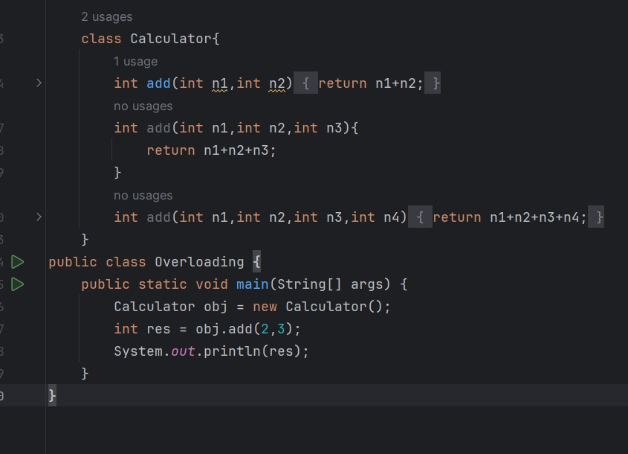

Slide 11
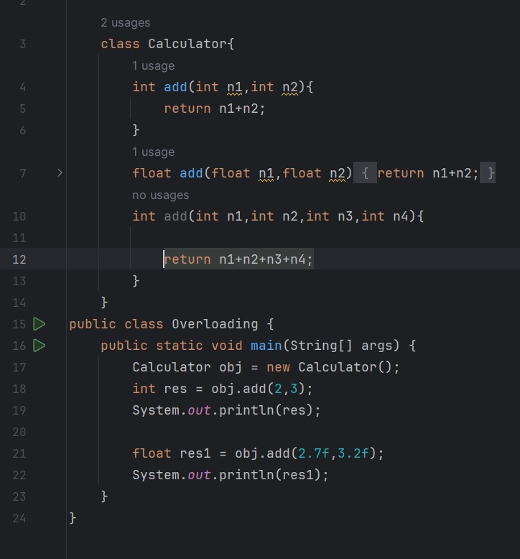

Slide 12
Encapsulation:
It means binding data and methods within a single unit i.e. “class”.
It is used to make sure that information can be only be accessed by certain methods rather than making them publicly available .
To achieve encapsulation declare variables using “private” access modifier.
To access these variables which are private one can use public getter and setter methods.
The get method is used for getting the value.
The set method is used for setting the value.

Slide 13
Abstraction:
It is the process of hiding certain details and showing only essential information to the user.
It is only partial hiding.
It can be achieved by interfaces concepts.
It helps to capture the essential attributes and behaviours of objects , making the code more organized and understandable.
It can also be achieved by using abstract keyword.
It is a non-access modifier.

